Slide 1
Mexico
By: Bryce Evans, Maria Claro, Terence Henriod, Brooke Biggs

Slide 2
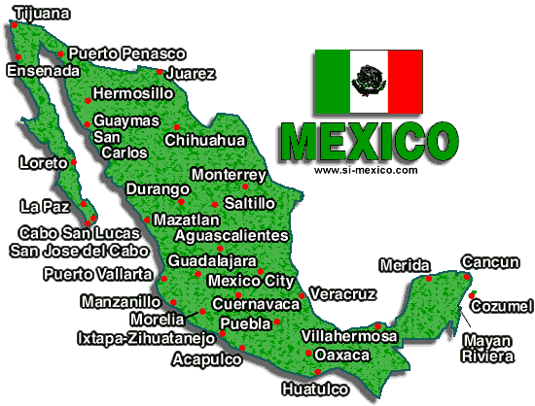
Background Information
Area: 761,600 square miles (Three times the size of Texas)
Population: 113,724,226
Health: Infant mortality rate--17.29/1,000. Life expectancy--male 73.65 years; female 79.43 years.
Mexico ranks 13th globally and 3rd in the Americas in total number of HIV cases reported, but the increase has been continuous since 1981.

Slide 3
With an estimated average of 4,000 new cases annually, AIDS has become the fourth leading cause of death for Mexican men aged 25 to 44.
In 2009 it was estimated that the amount of people living with HIV/AIDS in Mexico is 220,000 and deaths expected were ranging from 6,400 to 12,000.

Slide 4
Attitudes About Gender Roles
Most of the gender attitudes about men in Mexico is men should initiate sexual activity early in life and that they should have multiple sexual partners.
Men are also labeled as having to maintain control over the female partners.
Unsafe sex is more enjoyable than safer sex.

Slide 5
Women attitudes about gender roles include that women should not know much about sexuality, including how to protect themselves from HIV and other STIs.
Women should not negotiate protective behaviors with their male partners, such as condom use or monogamy.

Slide 6
Machismo
Machismo is traditional attitudes about masculinity which include beliefs that:
Men have more sexual urges than women
Men have the right to decide when and where to have sex
Men have the right to outside partners or relationships while women do not
Child care or parenting is primarily a woman’s issue

Slide 7
Strengths:
Limitations:

Slide 8
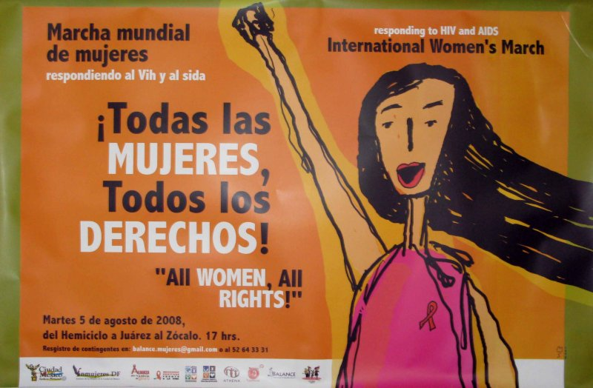
Media Clip

Slide 9
References

